Slide 1
Multi-player Game (Robot Soccer Simulation)
John Badji & Fherdinand Corcuera

Slide 2
world
Our Webots world (environment) consists of:
A soccer field with two goalposts.
Two teams of 3 players will be competing against each other.
2-wheel robots are used as players.
A soccer ball robot
An invisible robot referee

Slide 3
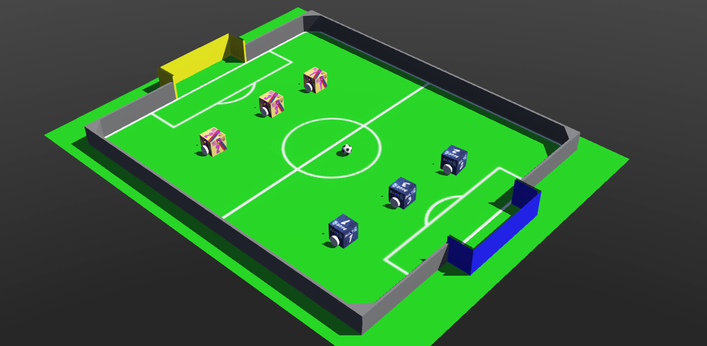

Slide 4
Game integrity
The game integrity (WYSIWIS)

Slide 5
Game integrity
The robot referee is responsible for upholding the integrity of the game.
It ensures that the rules are followed and perform tasks such as
announcing when a goal is scored,
resetting the ball and players to the kick-off position after a goal,
repositioning players, and
Resolving any lack of progress during the game. etc.
Notes:
Centralized decision taking model

Slide 6
Robot Communication
Each player robot is equipped with at least 3 receivers and 1 emitter.
First receiver is used to receive data from the supervisor(referee)
Second receiver is used to receive data from the ball
Third receiver and the emitter are used for intra-team communications
The Ball communicates signal strength and direction to the supervisor and players
The supervisor:
communicates kick-offs and goals to players
Receive messages from the ball.

Slide 7
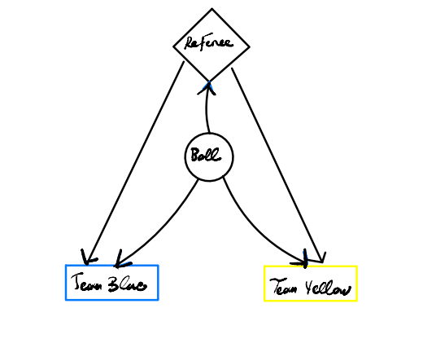
High Level overview of game architecture

Slide 8
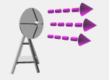
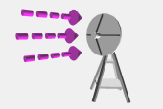
Intra – team communication
Each team is assigned a different channel through which to send and receive messages
All receivers listening on channel X receive the message if it was sent through an emitter on channel X.
Team A
Team B
X
Y
P1
P1
P2
P3
P2
P3

Slide 9
Game plan and strategies
Player roles and game logic

Slide 10
Player roles
Each team has three players, and each player is assigned a specific role.
Player 1
Player 2
Player 3
Player 1 has a defensive role:
- Chase the ball when the ball is in range and try to score
- Give up the ball when another team player is already on the ball in the offense zone
- Get back to the defensive zone when it can't see the ball
Player 2 has a center support role:
Chase the ball when the ball is in range and try to score
Give up the ball only when player 3 (offensive player) is already on the ball
Strategically place itself at the center when can't locate the ball
Player 3 has a striker's role:
- Chase the ball when the ball is in range and try to score
- Give up the ball to a teammate (player 1) only when in the defense zone
- Strategically place itself in the opponent’s danger zone when can’t currently locate the ball

Slide 11
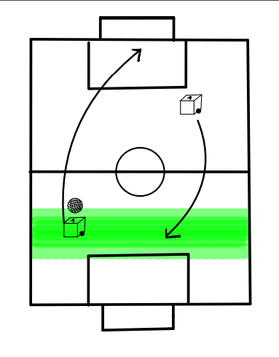
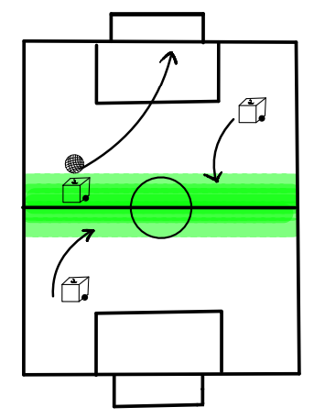
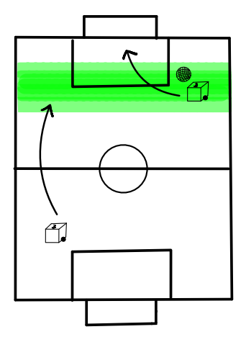
Player 1
Player 2
Player 3
Notes:
“Allowed territory”

Slide 12
Even though each player has a unique role, they all follow a common strategy that can be summarized as follows.
The underlying game logic is expanded by including new elements like
robot position,
heading (indicating the direction the robot is facing),
teammate identification and position.
Sonar values for object detection
This ultimately led to more realistic and seamless gameplay, with fewer instances of team members getting stuck in a deadlock.
Locate ball
Close to ball?
Attack /
Defend
Chase ball
Send ID to team
Caught ball?

Slide 13
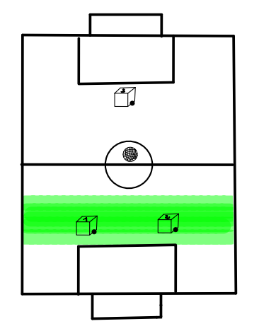
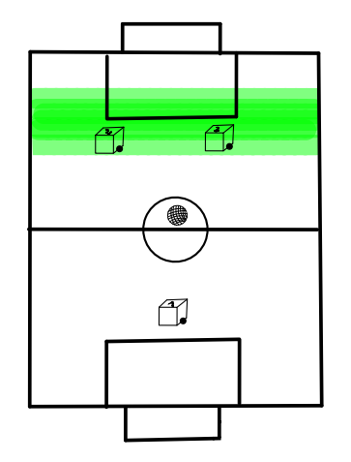
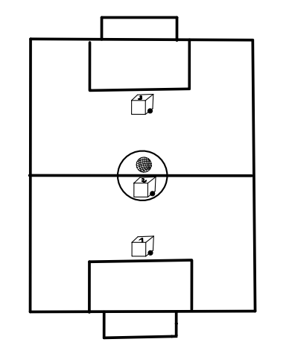
Game Plan and strategies Formation
Defensive
Offensive
Collaborative
During defensive play, both Player 1 and Player 2 assume a defensive stance. Should either player lose possession of the ball, they both promptly retreat to their team's defense zone.
During offensive play, both Player 2 and Player 3 assume an offensive stance. If either player loses the ball, they strategically position themselves in the opponent's team offensive zone.
During collaborative play, all players assume their assigned roles. All sections of the field is covered

Slide 14
How do team decide on strategies?
Originally, we wanted to be able to act like a coach and change strategy mid-game using keyboard input.
But due to time constraints, we weren’t able to set it up.
The strategy, we came up with is simple.
Player 1 acts as a sort of captain that decides on the strategy that the team will be playing
Player 1 then communicates the strategy to the rest of the team.

Slide 15

At this stage, team aren’t able to change strategy mid-game. Teams are stuck with one strategy for the duration of the game.
P1
Player 1 randomly choose strategy (D | O | C)
Players with jersey numbers 1 have an extra emitter (strategy emitter) through which they communicate strategy to the other 2 team members
P2
P1
P1 communicates strategy to teammates
The other 2 players also have an additional receiver through which they get the strategy message.
The strategy channel is separated from other communication channels
P3

Slide 16
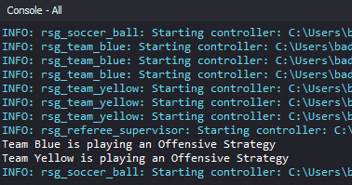
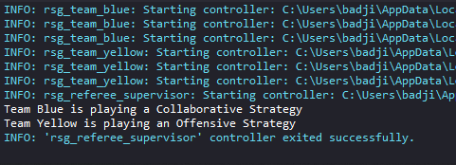
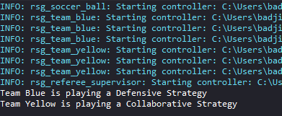

Slide 17
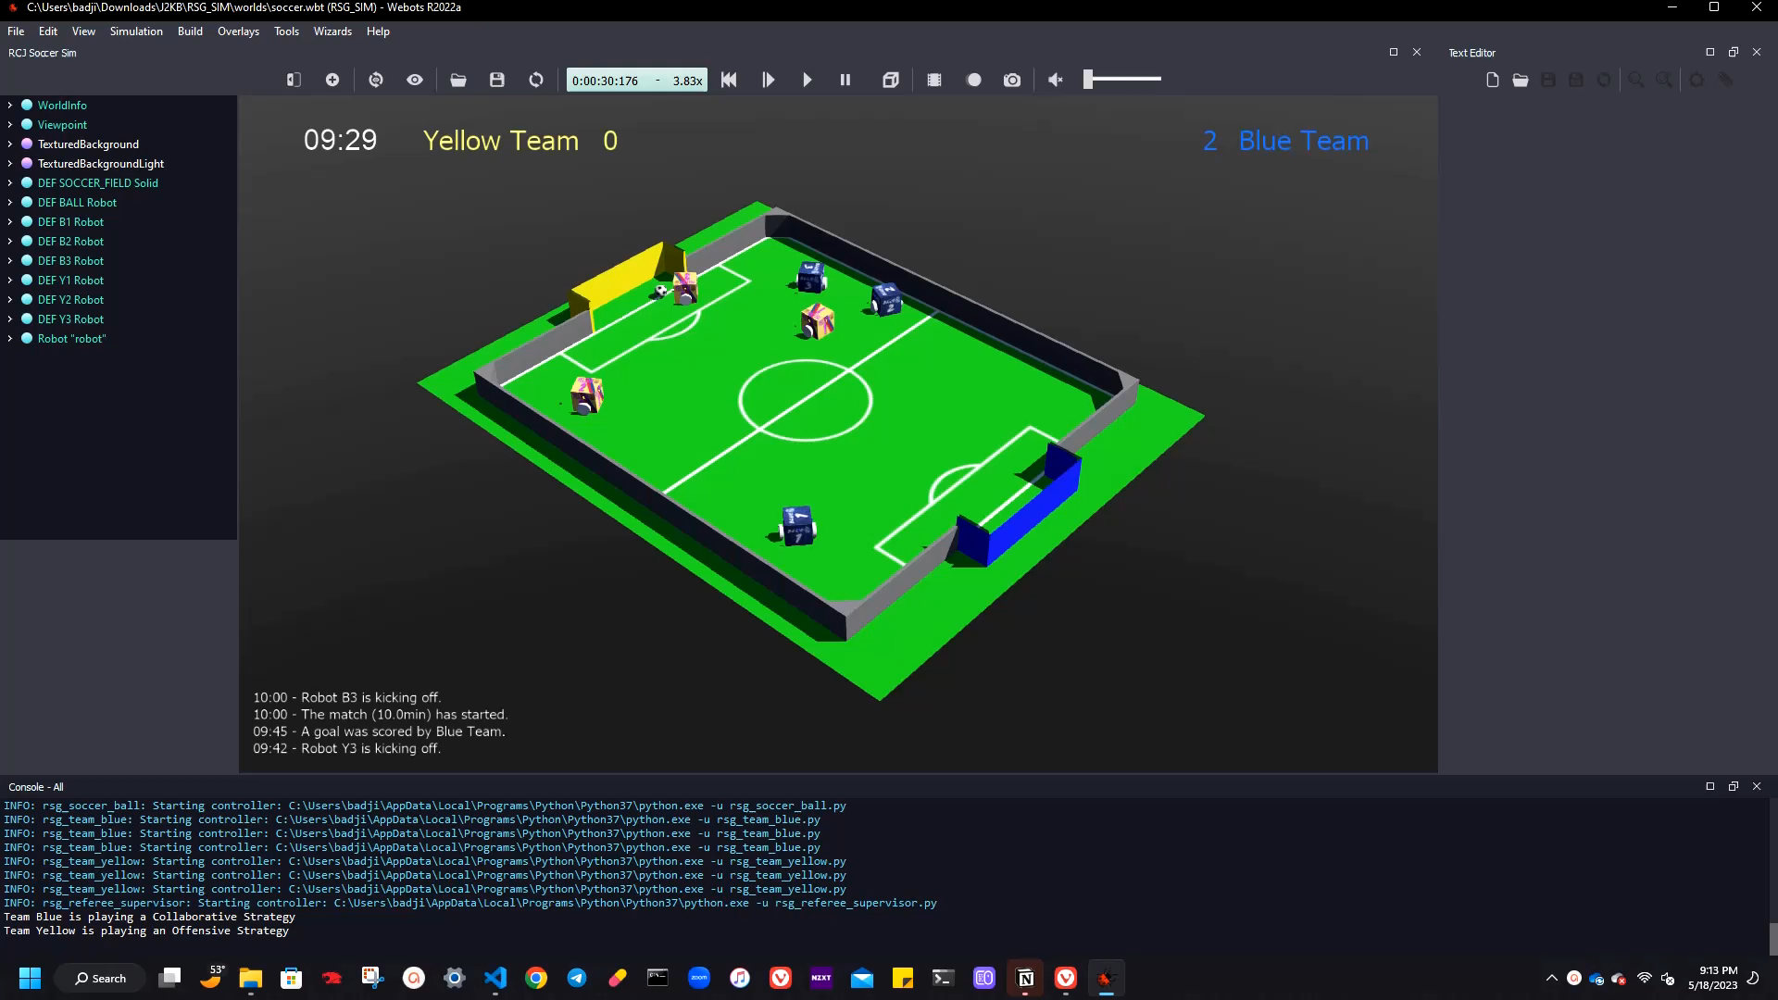
ACCELERATED SIMULATION RUN

Slide 18
How TO handle the Events in the game?
Functions were created that will display messages on the world tab.
These functions consist of:
Displaying a message if a team scores a goal.
Showing the name of the robot that is starting the kick-off.
Displaying the start and end time of the game.
A function that will call the message formatter based on the progress of the game was created.
This function will format and render the message, which can be seen on the screen.

Slide 19
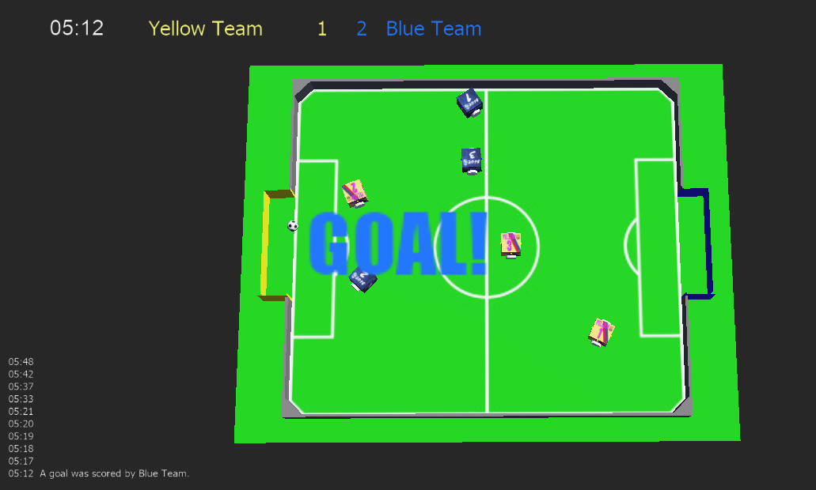

Slide 20
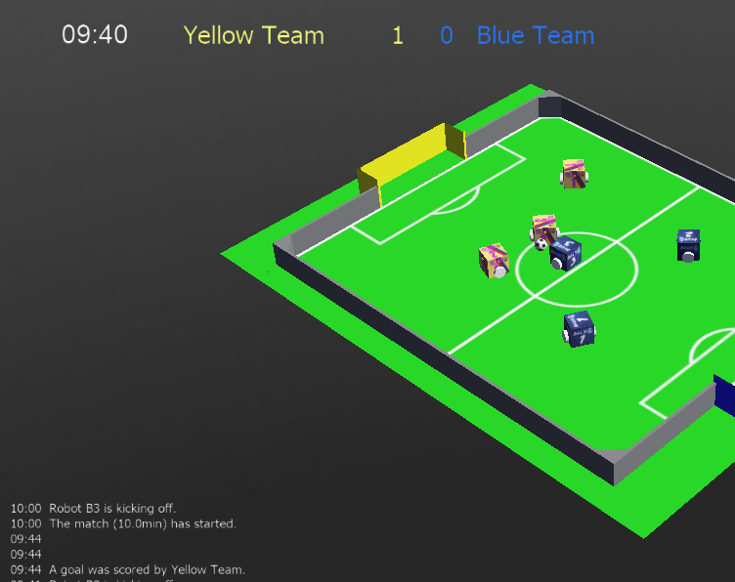

Slide 21
Progress tracker
The progress checker was necessary to display event messages.
"Track progress" was defined to enable the progress checker to react to a new position.
It tracks progress using a distance formula to calculate the distance from previous positions.
The computed data is then recorded to determine if an object has moved.

Slide 22
Referee Roles:
A function was defined to determine whether a goal was scored.
An initial position definition was created to track the ball's starting position.
An event subscriber was implemented to display messages on the world tab.
A message lineup was defined to process and display messages for each event.
A function to reset robot and ball positions to the initial position was included.
The referee function checks game progress, including goal scoring, ball placement, and kickoff setup.

Slide 23
Future Works:
Keyboard Input
Integrate a function that acts as a coach and changes strategy mid-game using keyboard input.
Improve communication with another robot.
Once improved, this aims to get the robot to communicate with one or more other robots on the playing field.
Coordination with other robots is crucial.
Once the communication between the robots has been enhanced, it is easier to program different activities to facilitate coordinated gameplay.

Slide 24
Conclusion:
An algorithm was developed to enable robots to autonomously participate in a soccer game using artificial intelligence.
The objectives of this project were successfully accomplished, which included the development of algorithms for communication and movement control.
The robot possesses impressive features, such as sensors, making it suitable for the simulator.
The achievement of allowing a single robot, operating in a virtual world, to perform a series of independent movements to locate a ball and direct it toward a goal was accomplished

Slide 25
THANK YOU

